Slide 1
Vehicle performance
Engineering Design Report

Slide 2
Outline
Design goal
Design flow
Vehicle dynamic study
Susupension kinematics
Validation
Performance analysis
Appendix

Slide 3
Design concept
Tire data oriented design
Enhance controllability in AutoX
Reduce steering effort

Slide 4
Design flow
Vehicle dynamic study
Suspension design
Validation
Lap time simulation
Kinematics design
Load tranfer distribution
Aerodynamic balance
Chassis roll stiffness
Load transfer
Performance analysis
Torque vectoring
Driver input
Set up tuning
MMM diagram
Tire data analysis

Slide 5
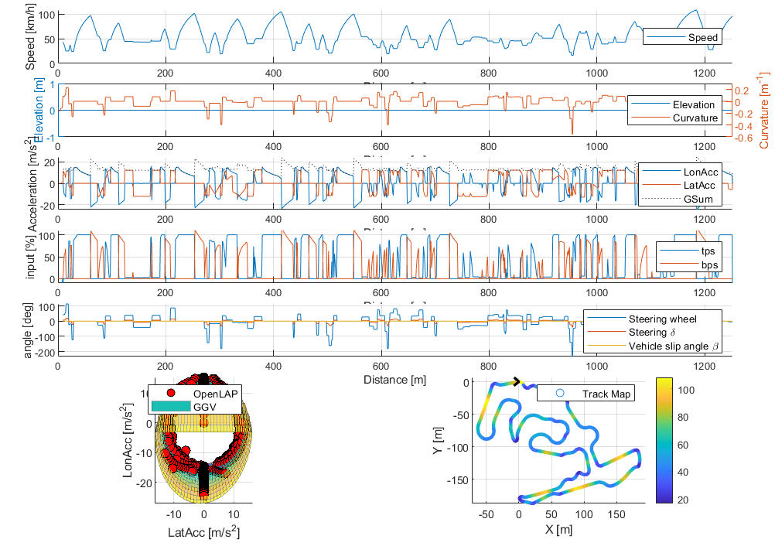
Vehicle dynamic study Lap time sim
FSG22 AutoX
TH06: 94.446
TH07: 93.089
Reduce 1.36 sec

Slide 6
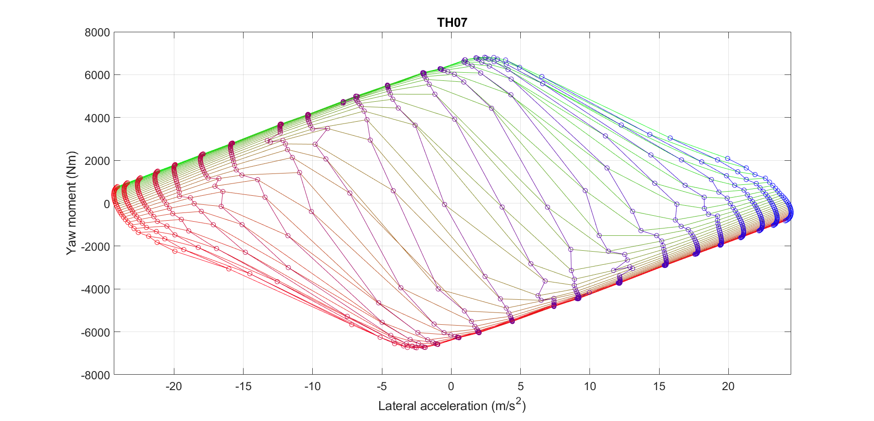
Vehicle dynamic study MMM diagram
Grip:1.75G
Balance: -300Nm @25m/s
Control:292Nm/deg
Stability:2321Nm/deg

Slide 7
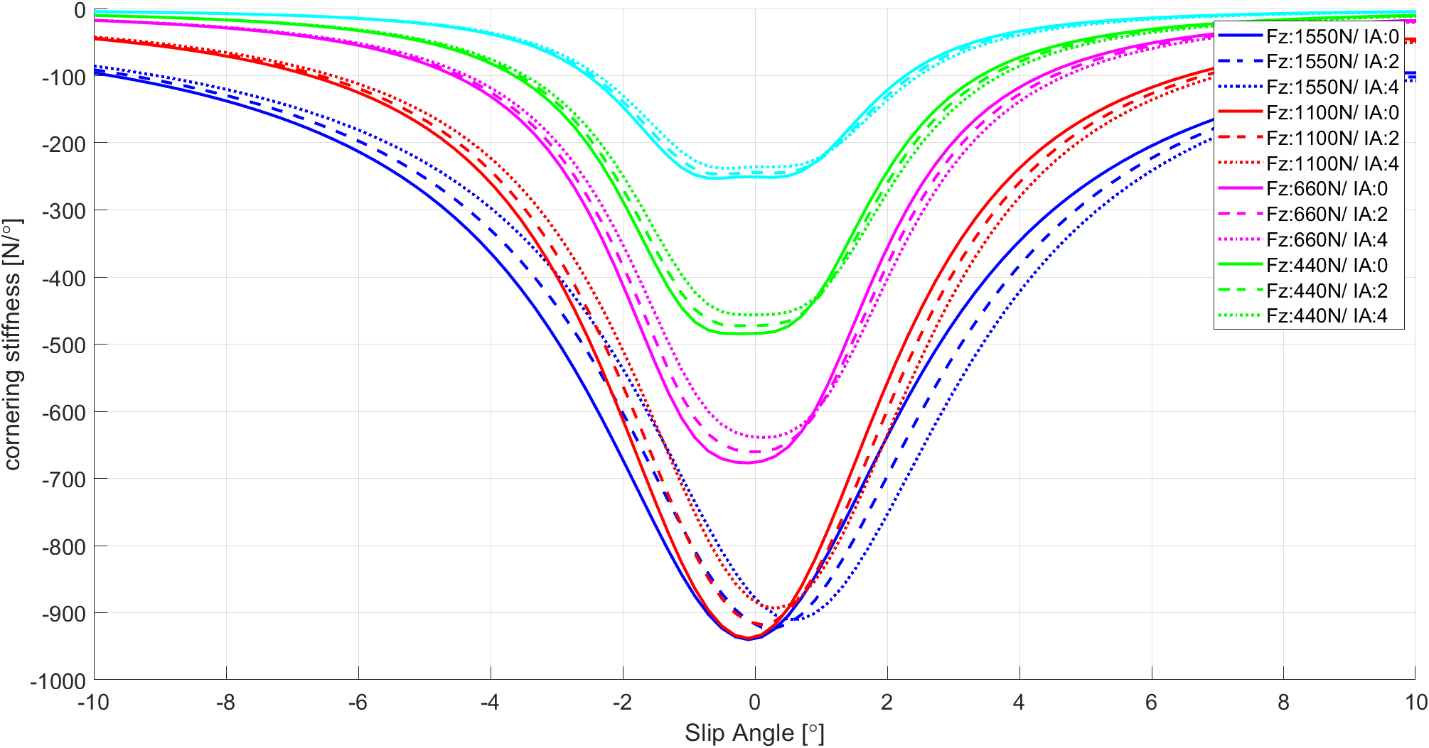
Vehicle dynamic study tire data acquisition
Need to minimize Camber gain

Slide 8
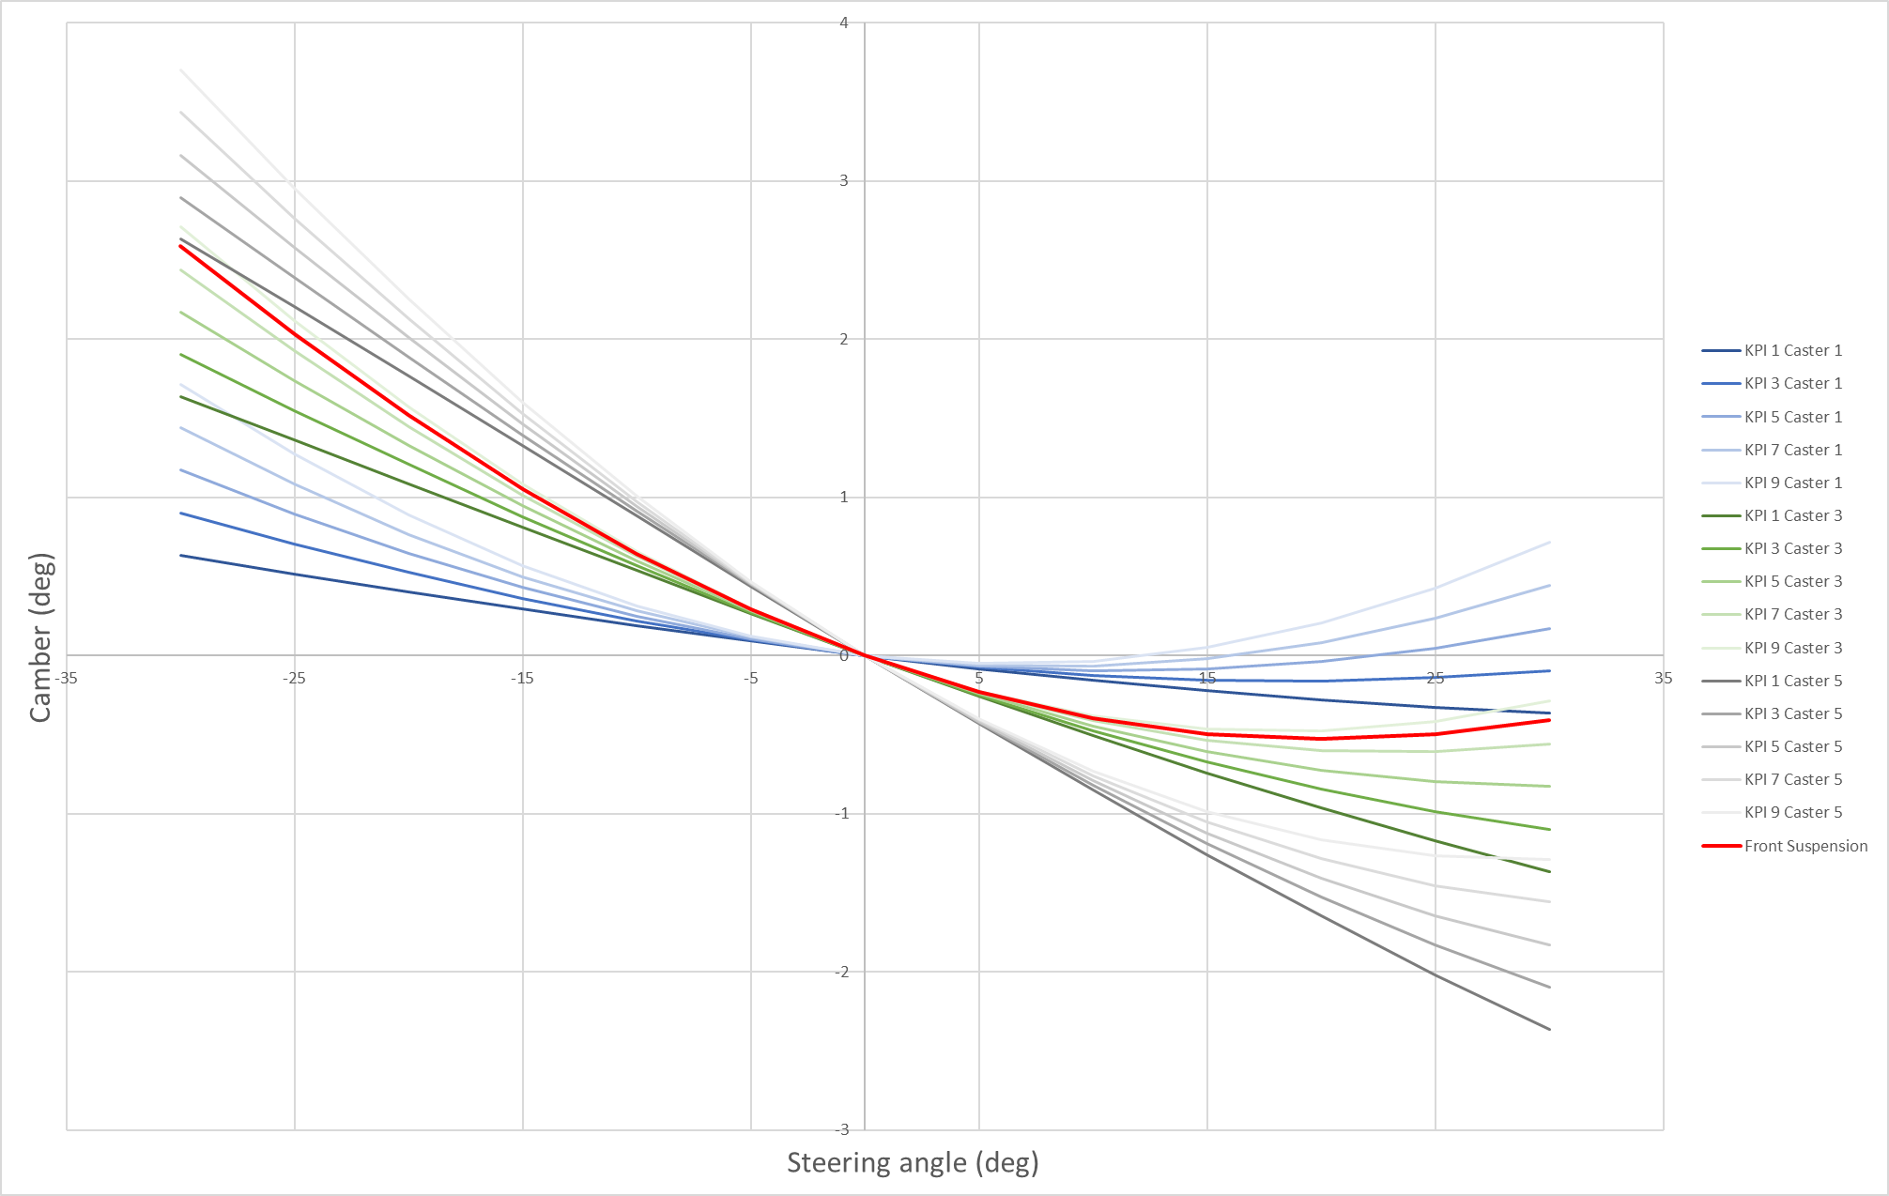
Suspension kinematics minimize camber change
Inner Wheel
Outer Wheel
Camber Change Within 0.5deg

Slide 9
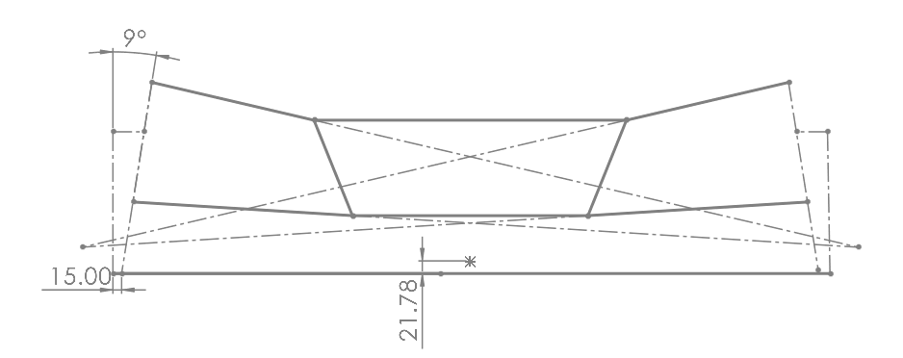
Suspension kinematics Front suspension geometry

Slide 10
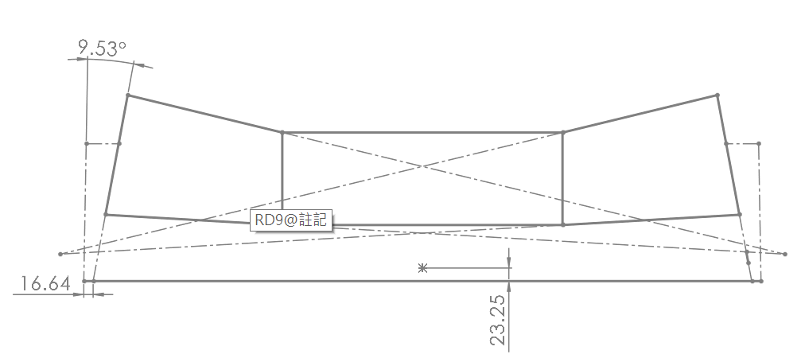
Suspension kinematics Rear suspension geometry

Slide 11
Suspension kinematics Kinematic roll center

Slide 12
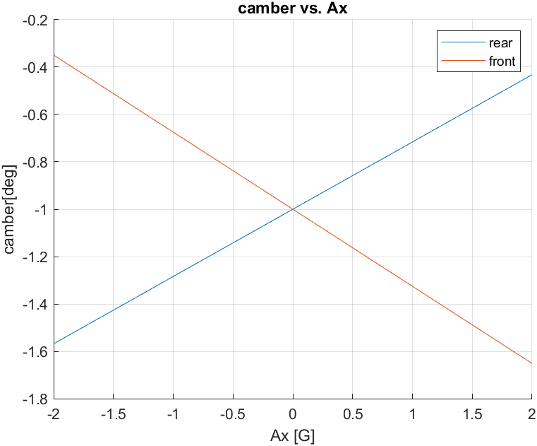
Suspension kinematics Tire attitude

Slide 13
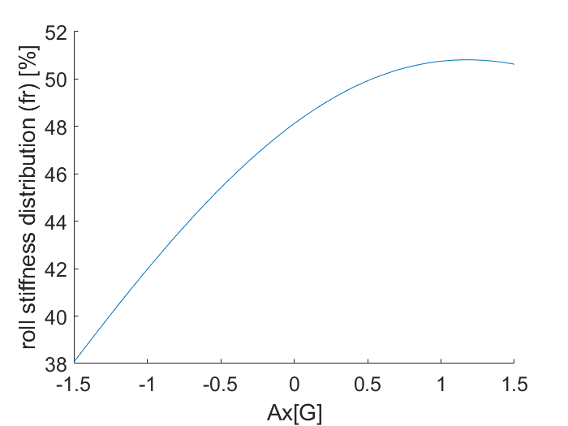
Suspension kinematics adaptive steering charateristic
oversteer
understeer
Notes:
Design nonlinear motion ratio
Create less understeer when corner entry

Slide 14
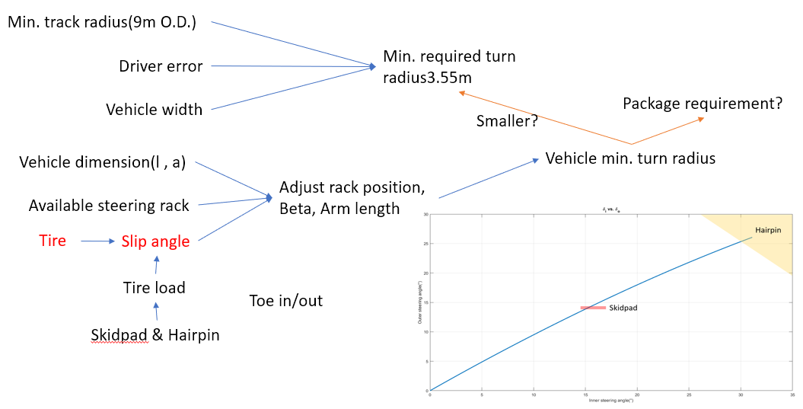
Steering Design flow

Slide 15
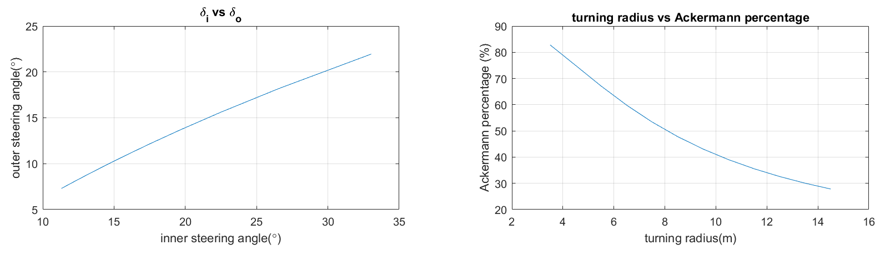
Steering turning radius vs optimum Ackermann percentage
Less understeer when corner entry

Slide 16
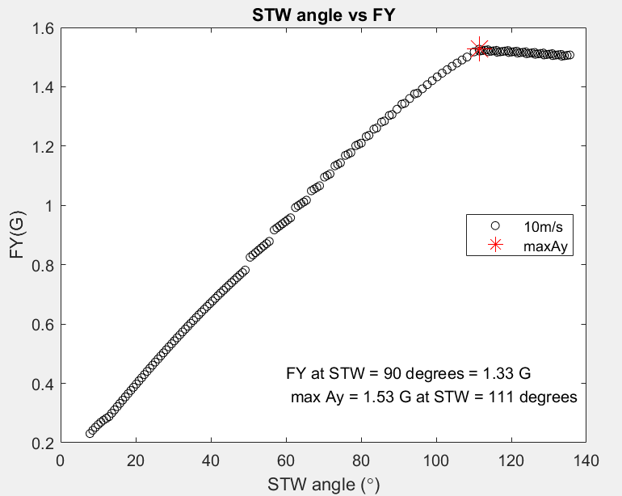
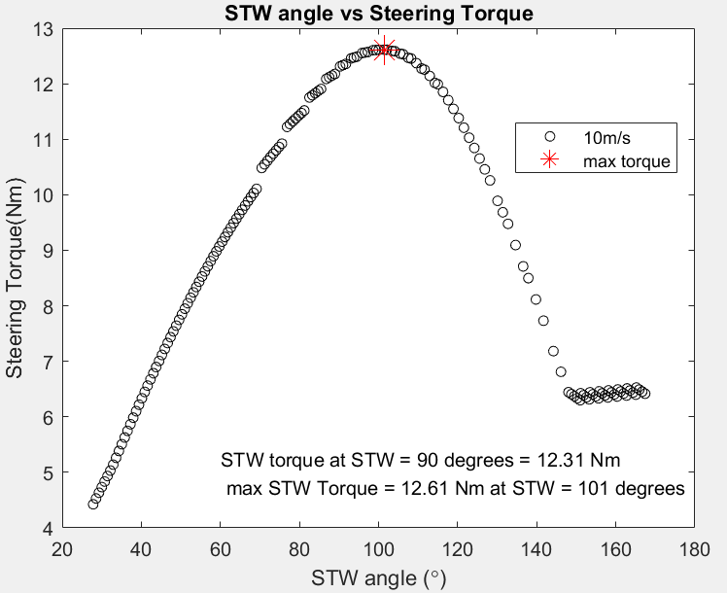
Steering steering geometry design
Notes:
Developing a simple model of TH07, we estimated the steering response of steady velocity.
We designed the effective steering arm length curve of TH07, which can fully transform tire situation, also giving a warning to driver that the tire is close to its lateral force limit.

Slide 17
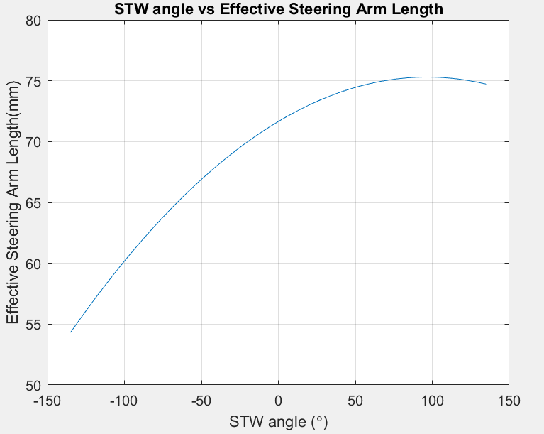
Steering steering geometry design

Slide 18
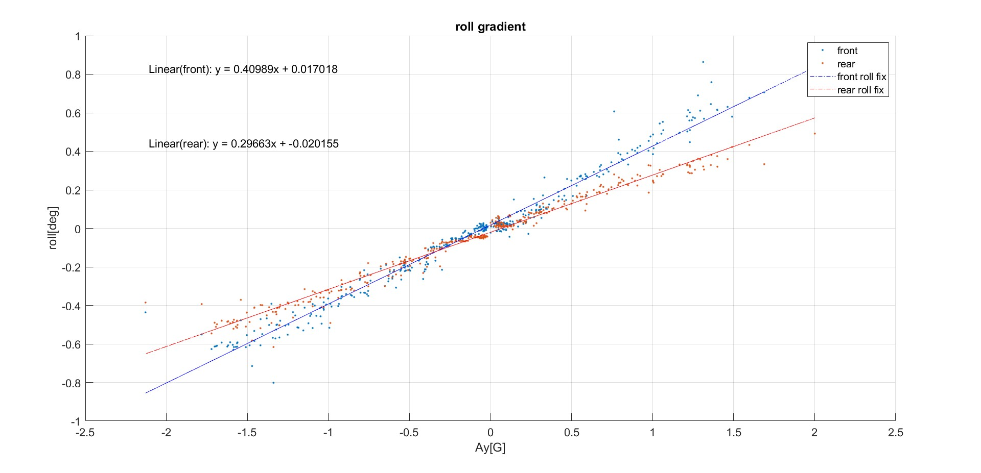
Validation Roll gradient
Constant radius acceleration test

Slide 19
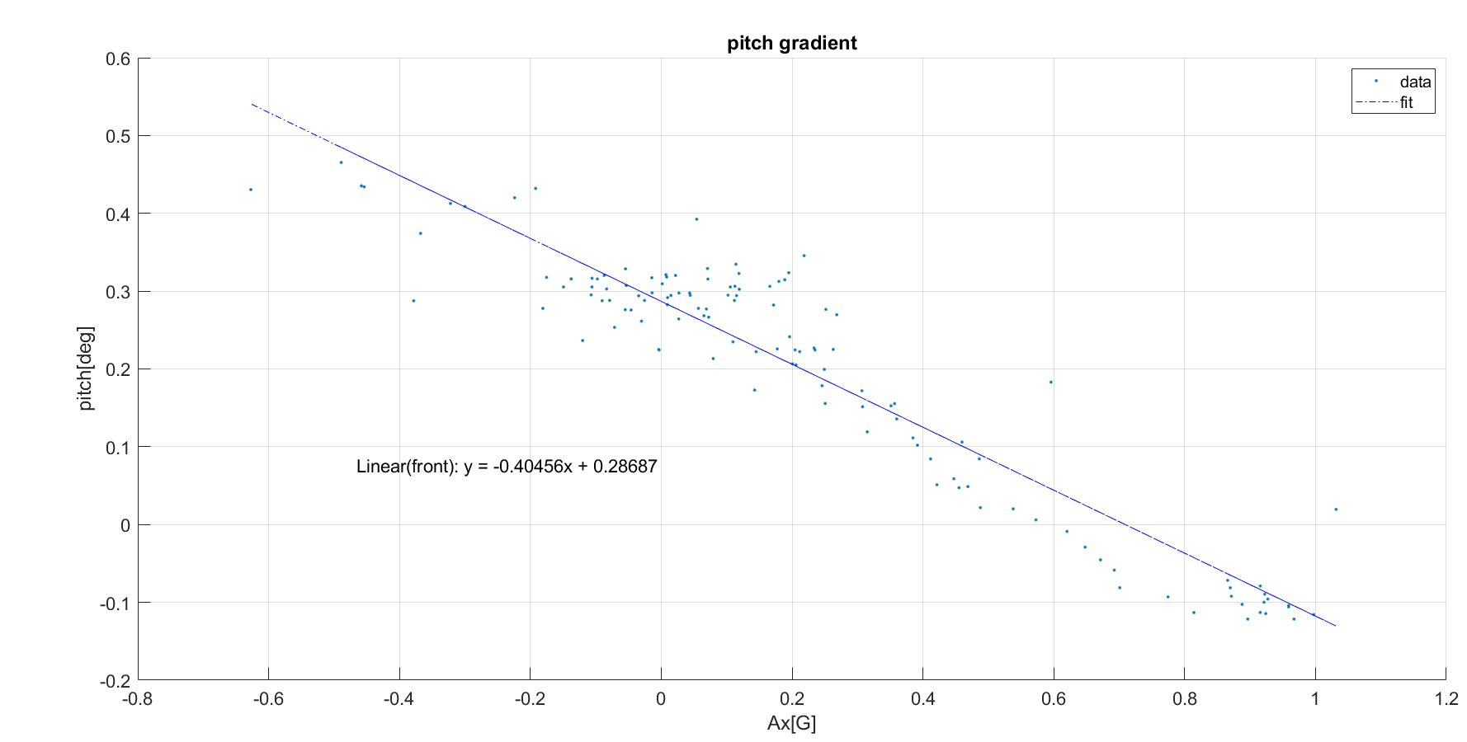
pitch gradient validation
Designed: 0.47 deg/G

Slide 20
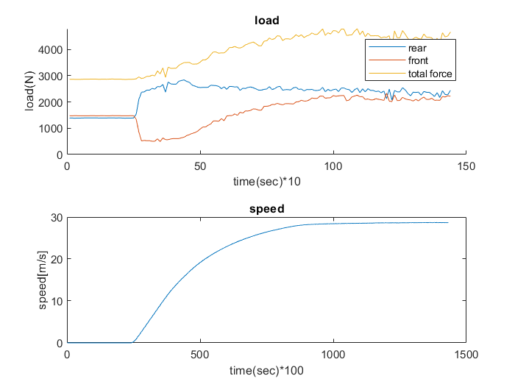
Validation Aerodynamic balance

Slide 21
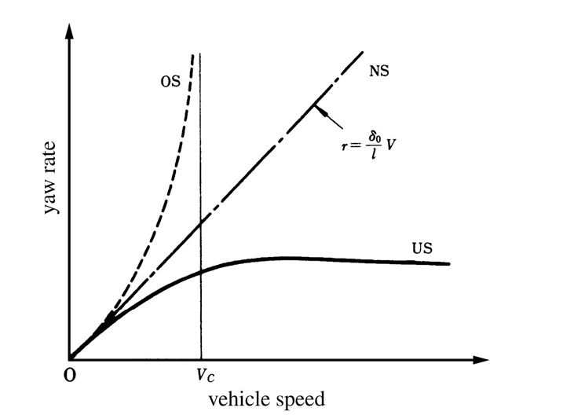
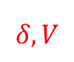
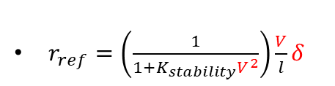
Performance analysis Torque vectoring framework
Adjustable
$r_{ref}=\left(\frac{1}{1+K_{stability}V^{2}}\right)\frac{V}{l}δ$
$$δ, V$$
Driver Interpretation
Ref. Yaw Rate
+
-
PID
Difference Torque
IMU
Yaw Rate
Notes:
俯瞰圖 小車三角形 減緩understeer
This is the framework of our torque vectoring system, according to the vehicle’s speed and steering angle together with our driver’s interpretation, a reference yaw rate is determined then compared to the current yaw rate measured by the IMU. Finally the difference torque is calculated with a PID controller.

Slide 22
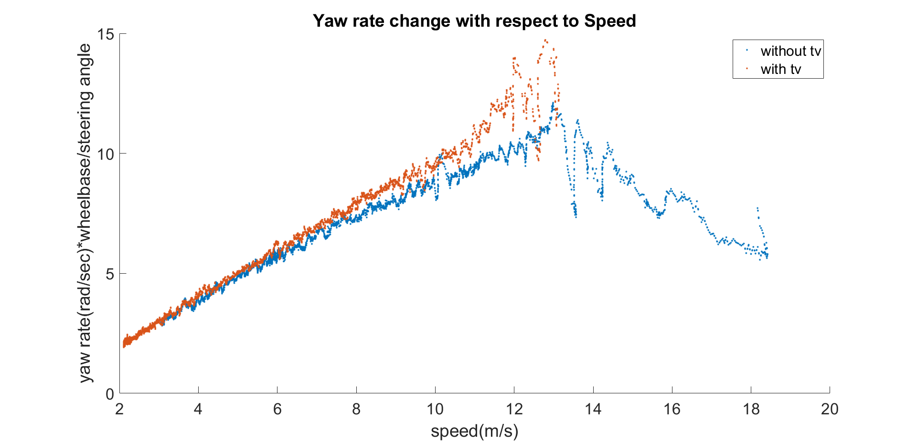
Performance analysis Torque vectoring
Less understeer

Slide 23
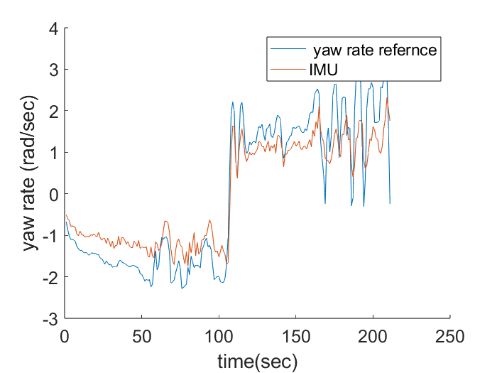
Performance analysis driver input analysis

Slide 24
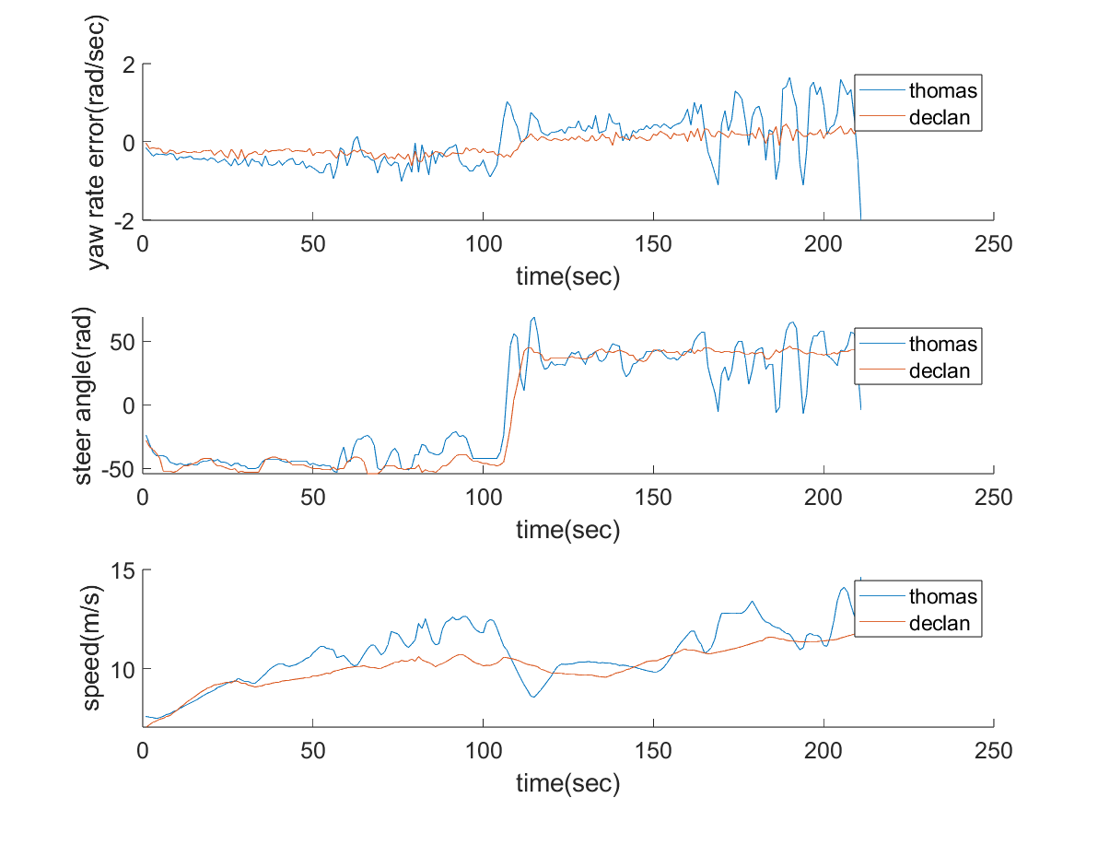
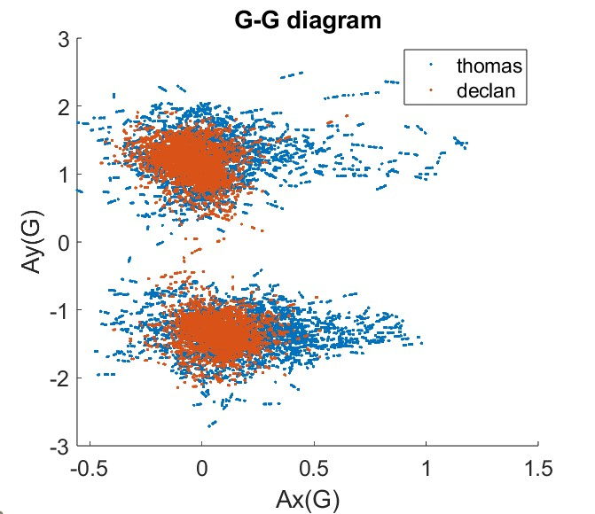
Performance analysis driver input analysis

Slide 25
Performance analysis systematic driver feedback

Slide 26
Performance analysis set up tuning
Response
Grip
spring rate
Driver sensing
TV
Steering characteristic
maneuverability
ARB rate
Minimize control effort
Notes:
在懸吊中主要調整的參數有，防傾桿扭轉剛性以及彈簧剛性，今年的設計目標為增加懸吊參數的可調性，讓車輛可以根據不同的賽道、車手、輪胎工作溫度…等外在因素去做因鷹的調整，盡量去配合車手的開車風格並開出最佳圈時。 而主要影響輪胎抓地力以及車輛暫態響應的是彈簧剛性，影響操控性以及轉向特性的是防傾桿以及彈簧剛性。 因此，我們會先根據圈時來調整彈簧剛性，在調整至最佳圈時之後，再根據車手回饋調整防傾桿扭轉剛性，配合賽道配置以及車手感受。

Slide 27
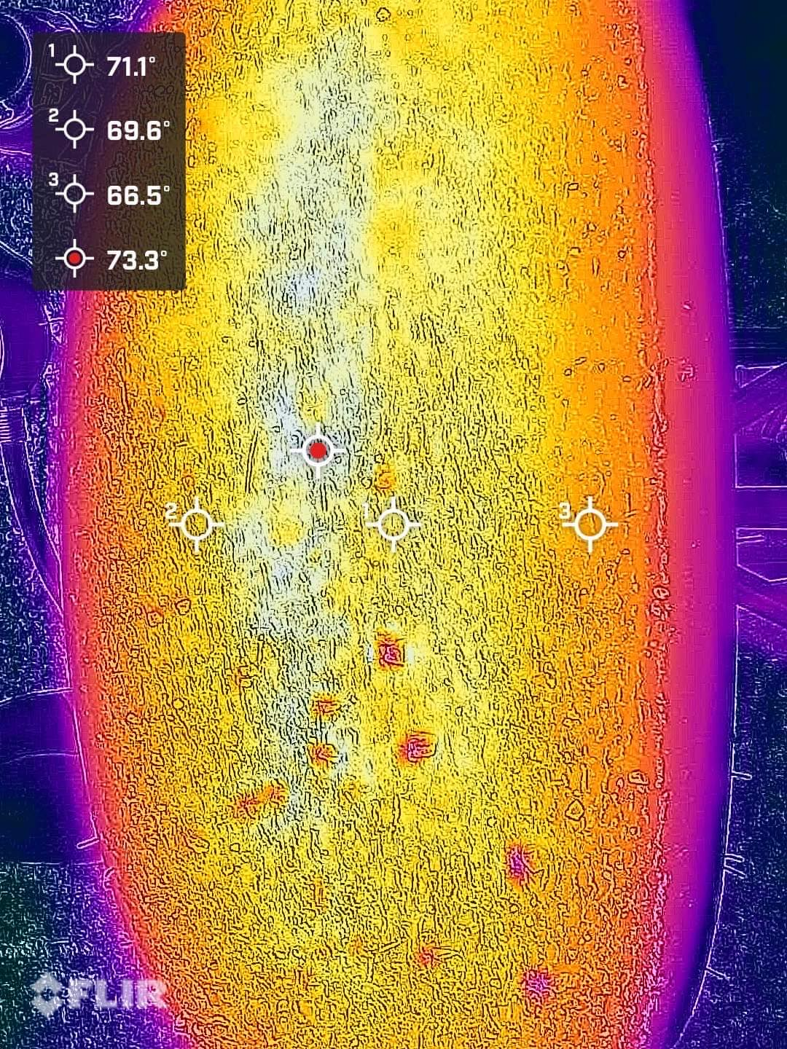
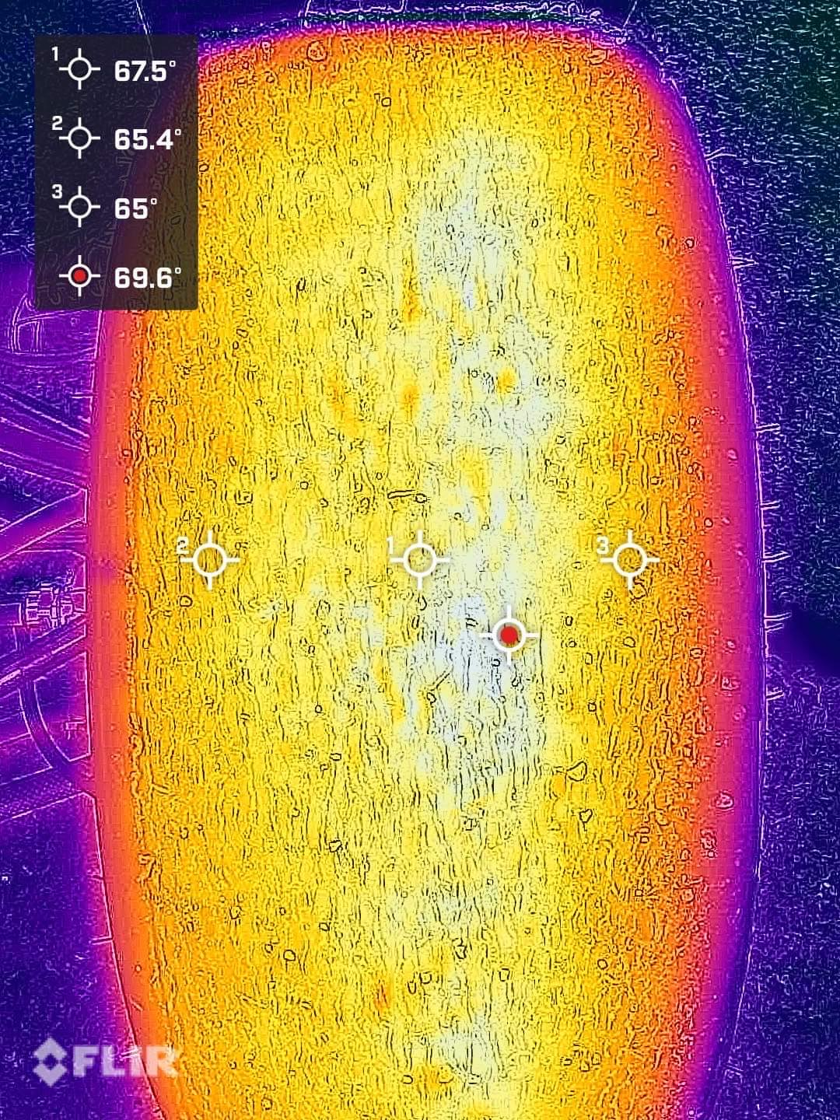
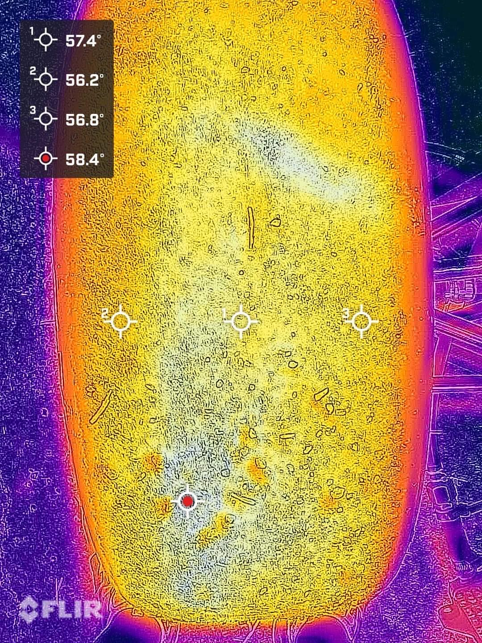
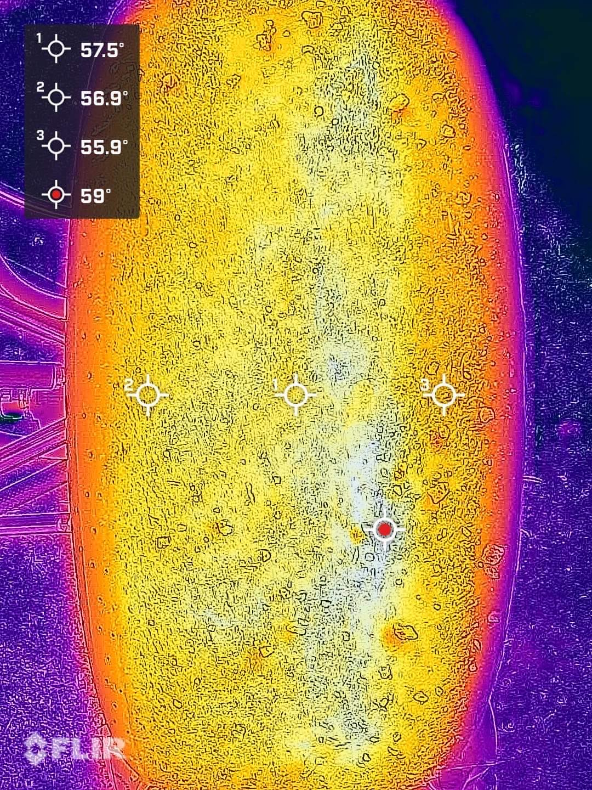
Performance analysis set up tuning
73.3
69.6
Driver feedback:
Too much udersteer
Data analysis:
Too much wear on front tyre
Faster front tire heating
58.4
59
Notes:
在懸吊中主要調整的參數有，防傾桿扭轉剛性以及彈簧剛性，今年的設計目標為增加懸吊參數的可調性，讓車輛可以根據不同的賽道、車手、輪胎工作溫度…等外在因素去做因鷹的調整，盡量去配合車手的開車風格並開出最佳圈時。 而主要影響輪胎抓地力以及車輛暫態響應的是彈簧剛性，影響操控性以及轉向特性的是防傾桿以及彈簧剛性。 因此，我們會先根據圈時來調整彈簧剛性，在調整至最佳圈時之後，再根據車手回饋調整防傾桿扭轉剛性，配合賽道配置以及車手感受。

Slide 28
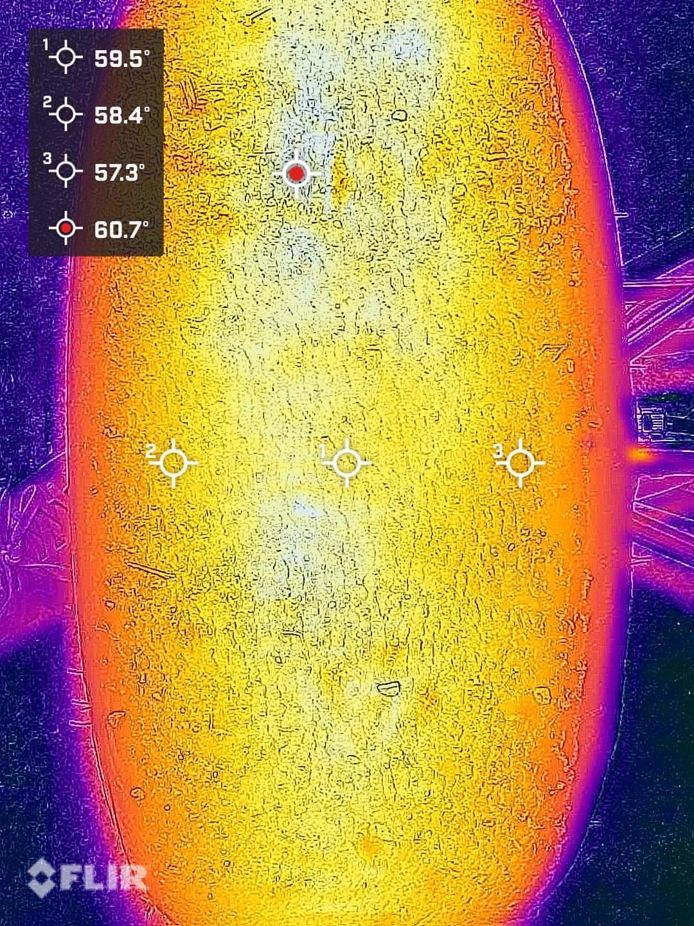
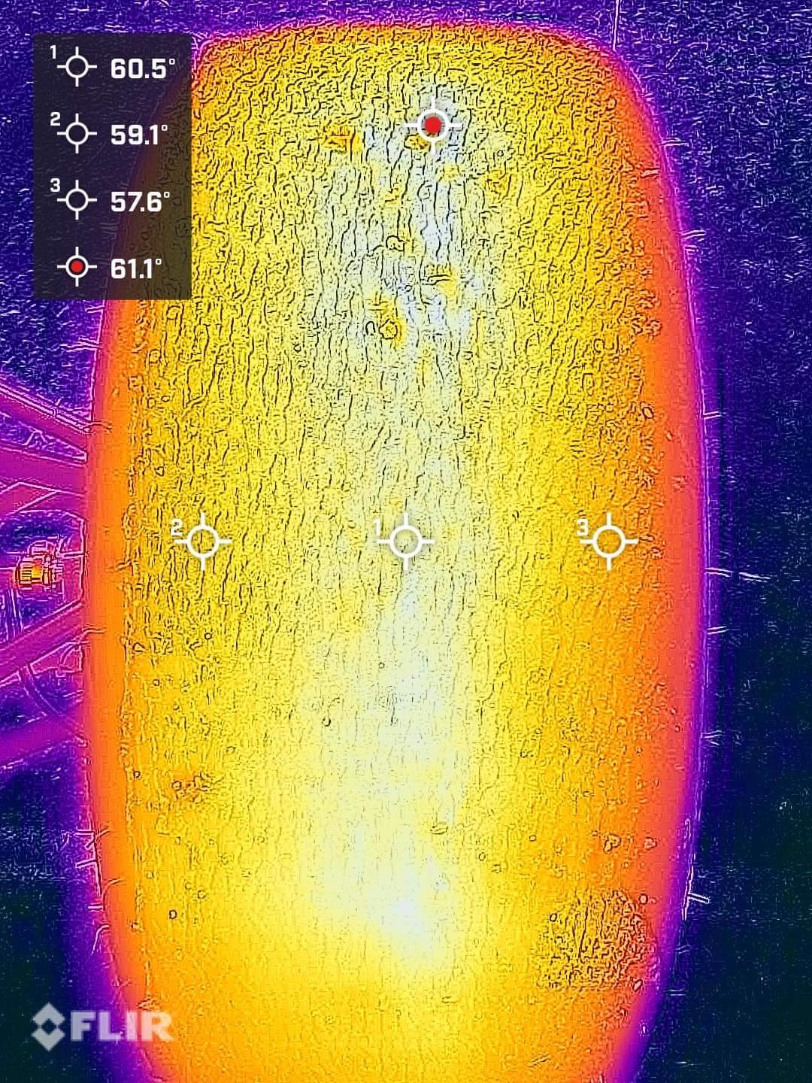
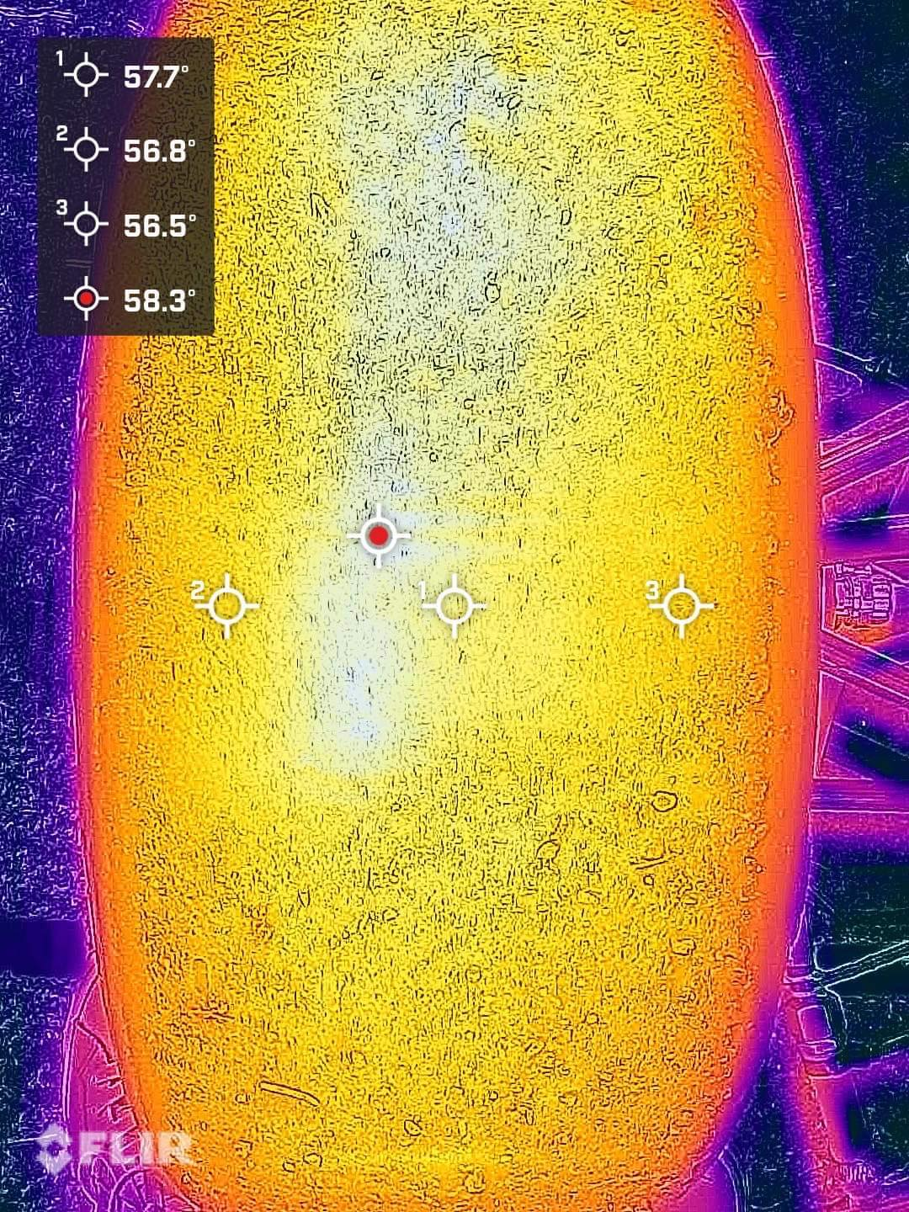
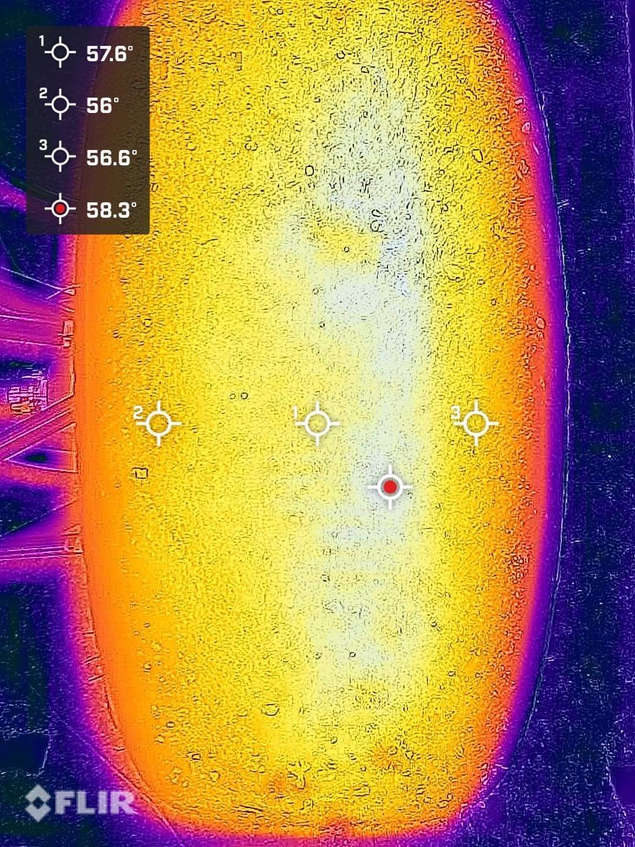
Performance analysis set up tuning
60.7
61.1
Driver feedback:
Less udersteer
Data analysis:
Less front & rear temperature difference
58.3
58.3
Notes:
在懸吊中主要調整的參數有，防傾桿扭轉剛性以及彈簧剛性，今年的設計目標為增加懸吊參數的可調性，讓車輛可以根據不同的賽道、車手、輪胎工作溫度…等外在因素去做因鷹的調整，盡量去配合車手的開車風格並開出最佳圈時。 而主要影響輪胎抓地力以及車輛暫態響應的是彈簧剛性，影響操控性以及轉向特性的是防傾桿以及彈簧剛性。 因此，我們會先根據圈時來調整彈簧剛性，在調整至最佳圈時之後，再根據車手回饋調整防傾桿扭轉剛性，配合賽道配置以及車手感受。

Slide 29
Tool development

Slide 30
Tire grip estimation
Linear potentialmeter
displacement
Suspension model
Tire model
car attitude
Load
GSS
Sideslip angle
FY
FX
Yaw rate
IMU
slip angle
Steering sensor
Steering sensor

Slide 31
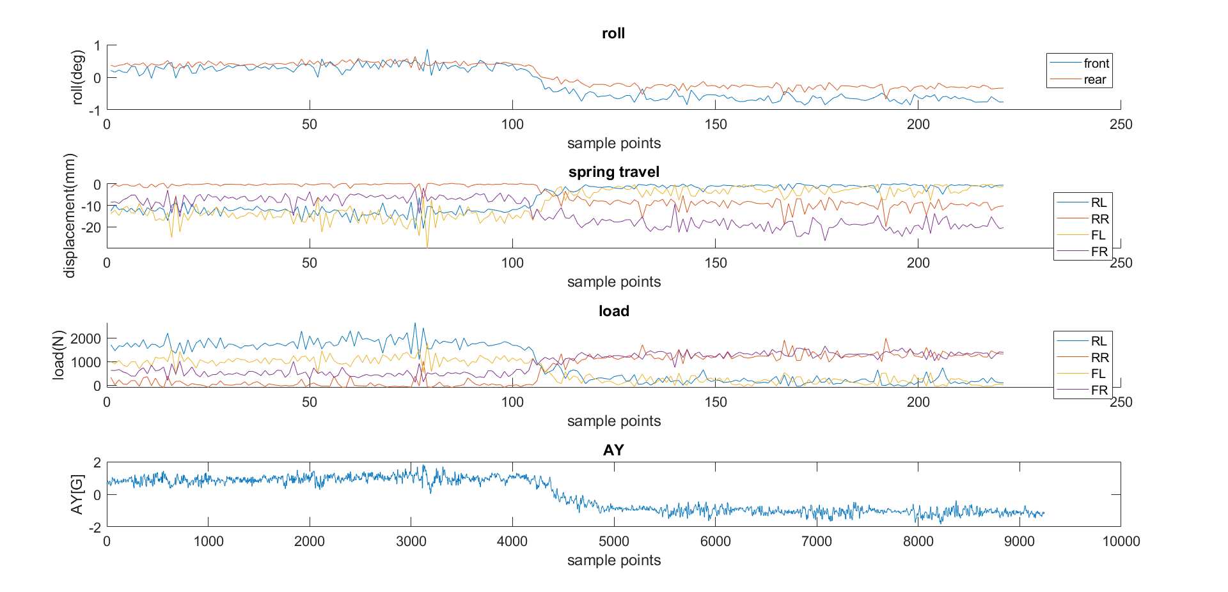
Tire load estimation

Slide 32
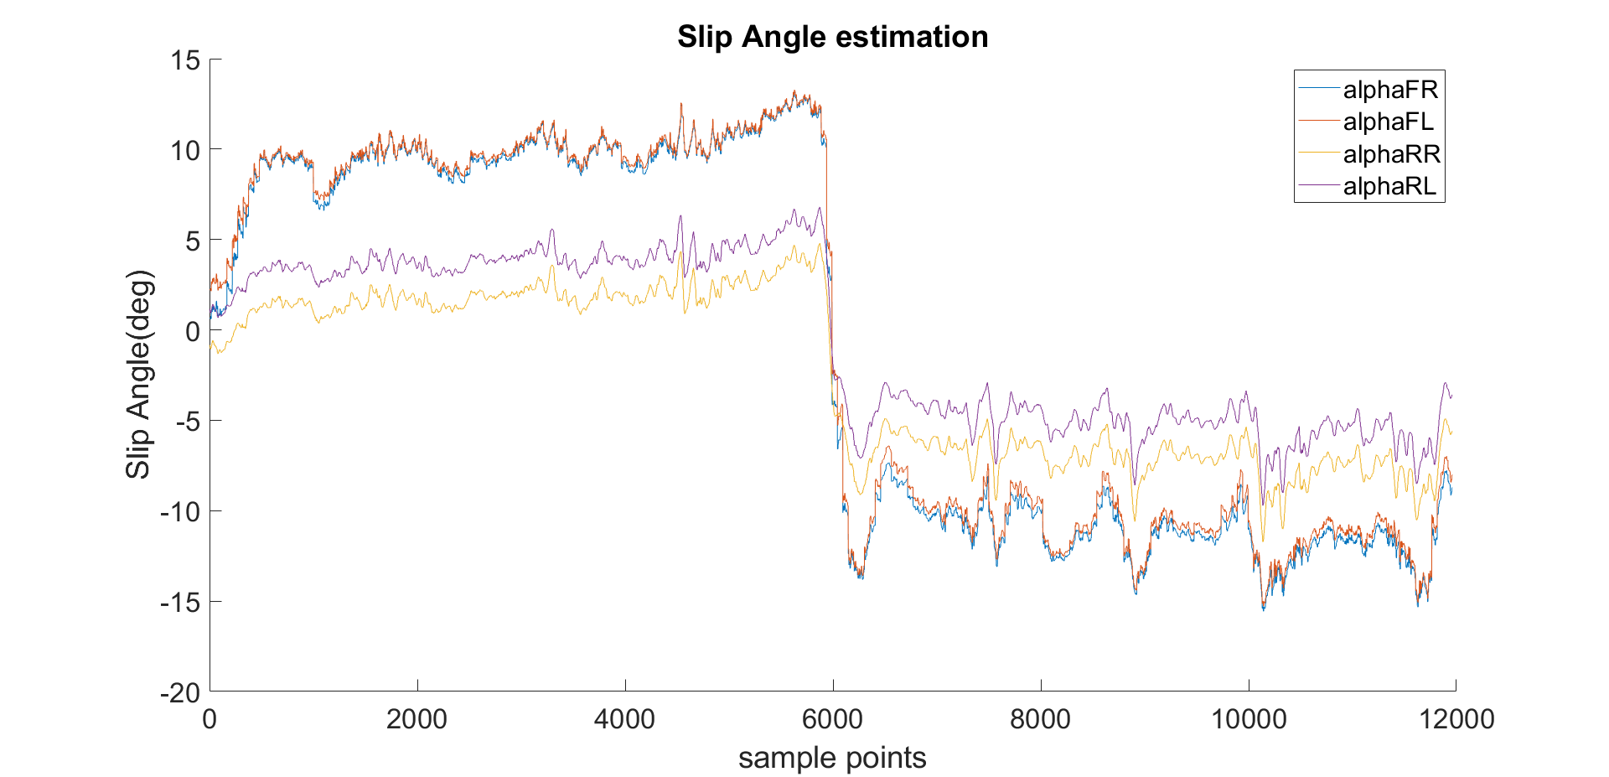
Slip angle estimation

Slide 33
Appendix
Tire data/Suspension mechanism/Set up sheet

Slide 34
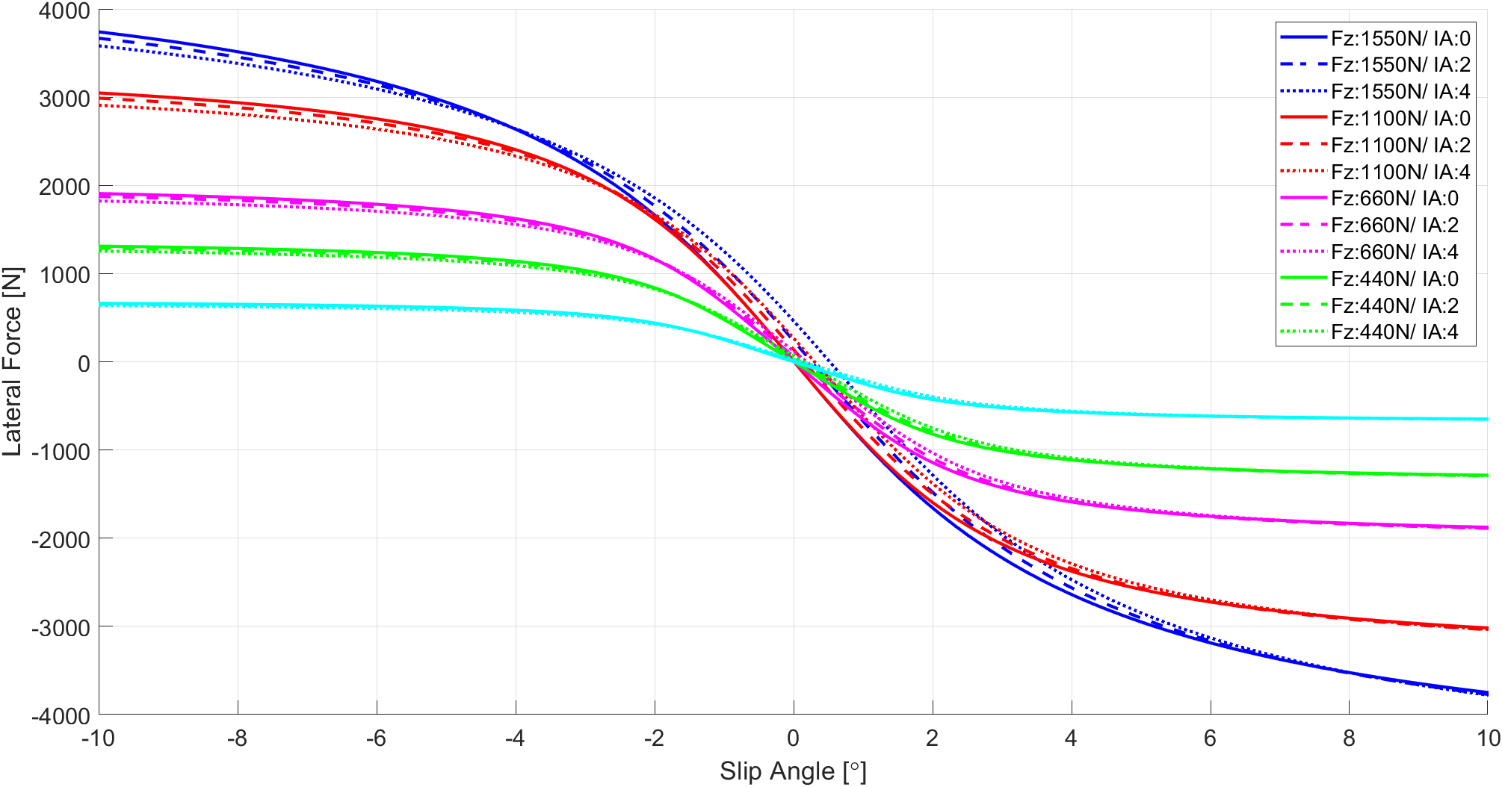
Tire data lat. force

Slide 35
Tire data cornering stiffness

Slide 36
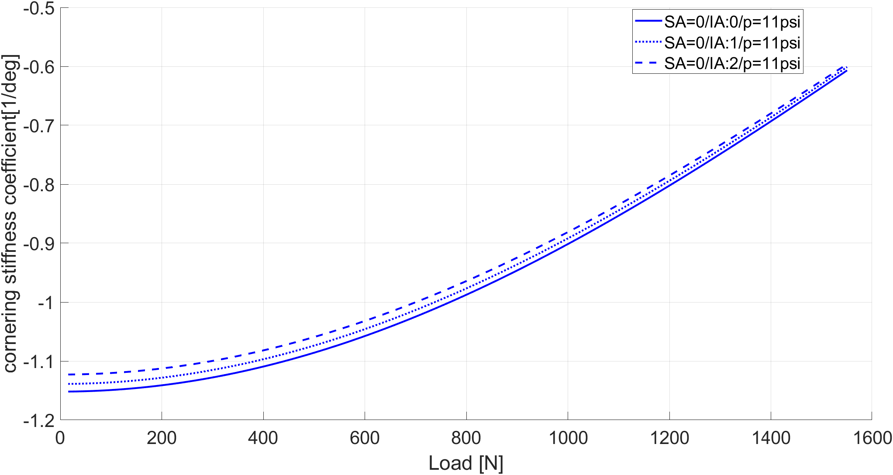
Tire data cornering stiffness coefficient

Slide 37
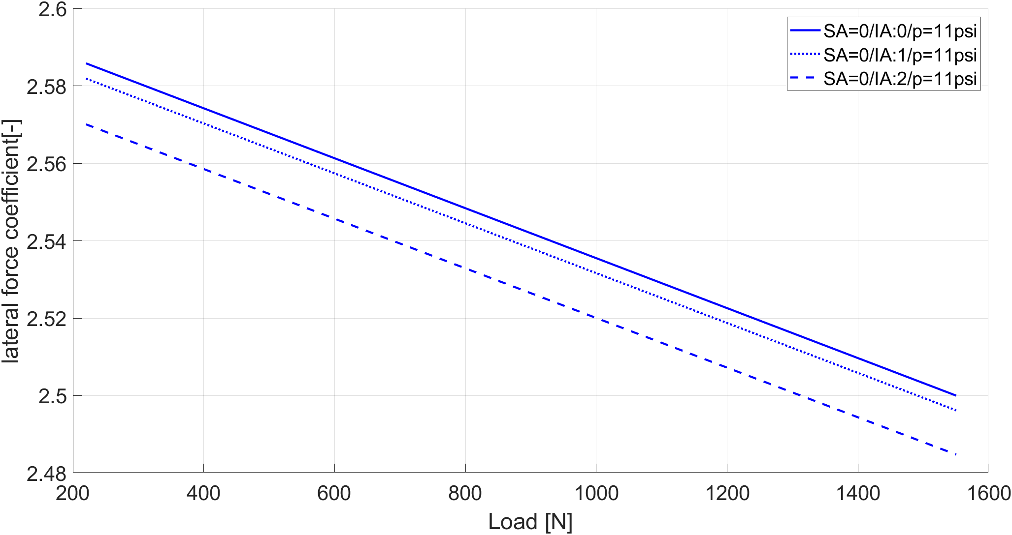
Tire data lat. force coefficient

Slide 38
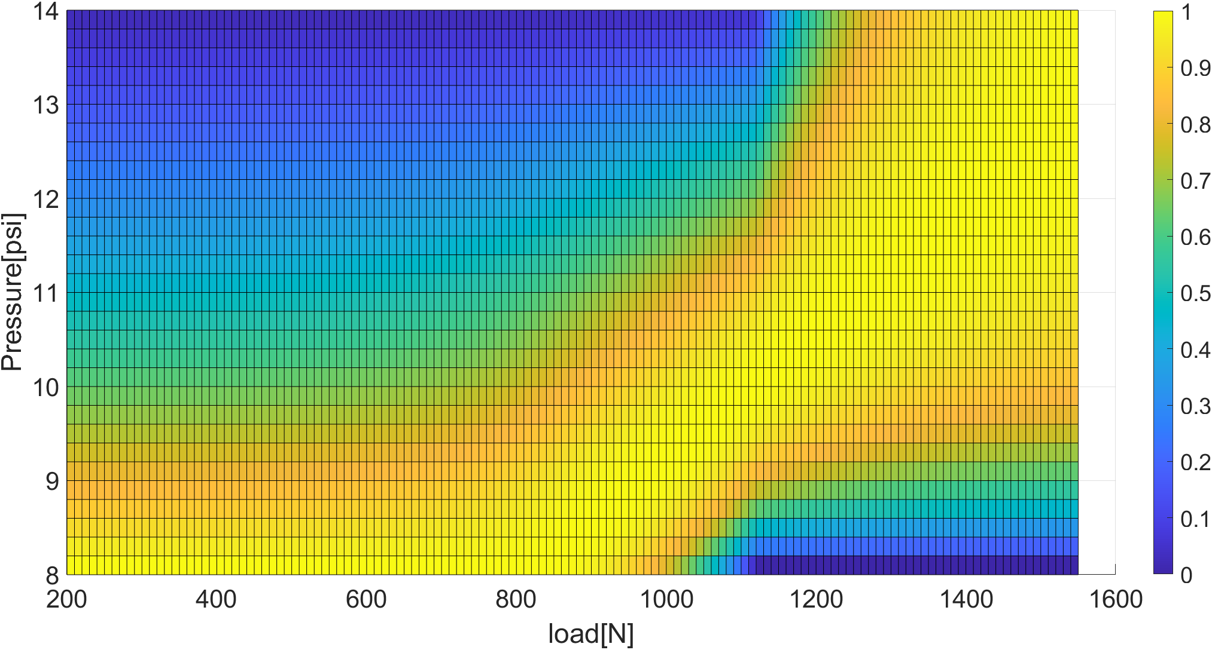
Tire data optimal pressure (Fy)

Slide 39
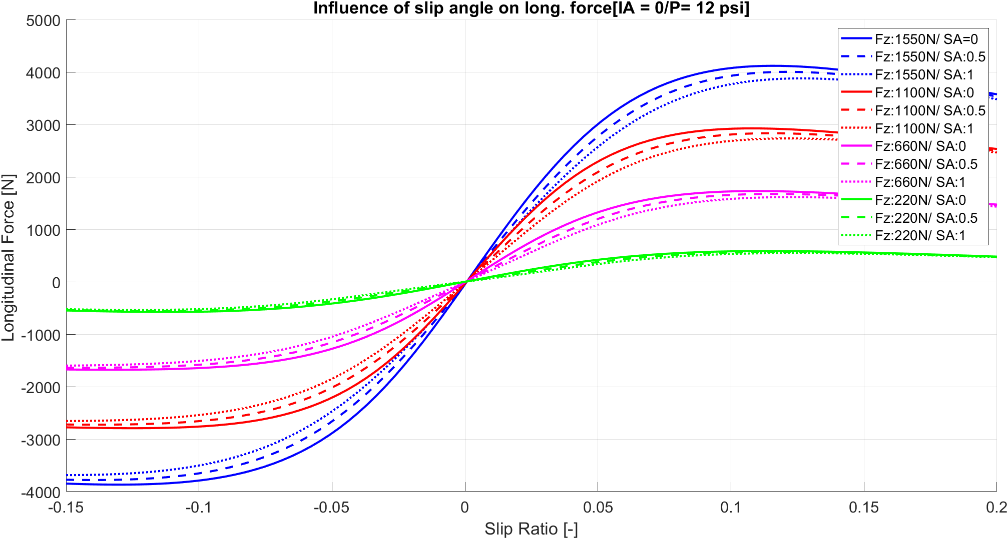
Tire data long. force

Slide 40
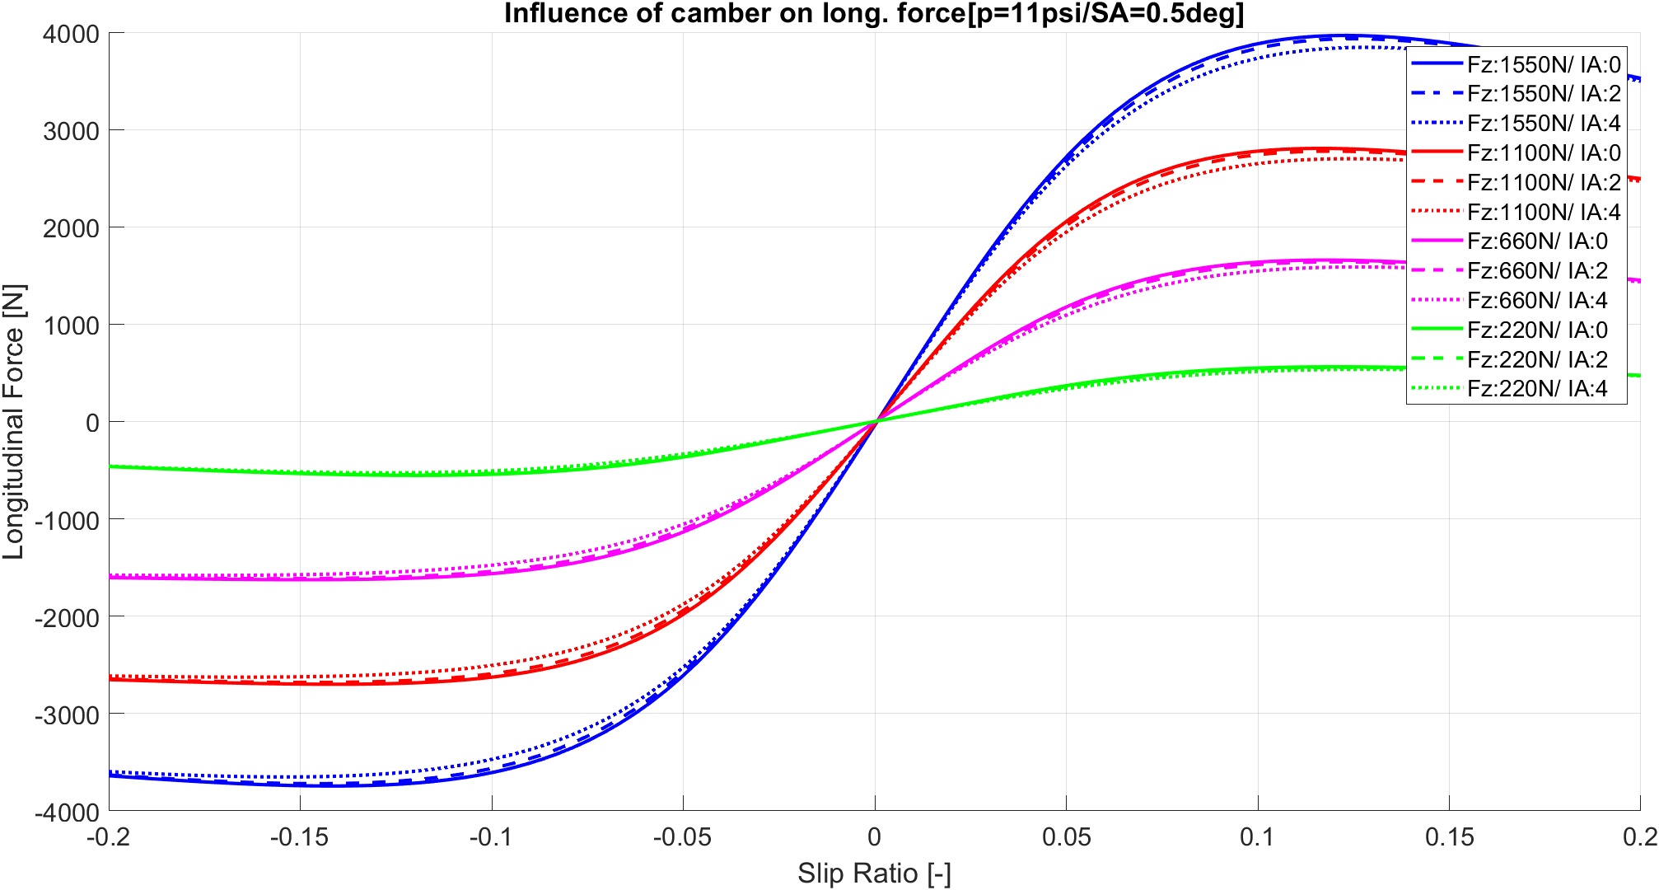
Tire data long. force

Slide 41
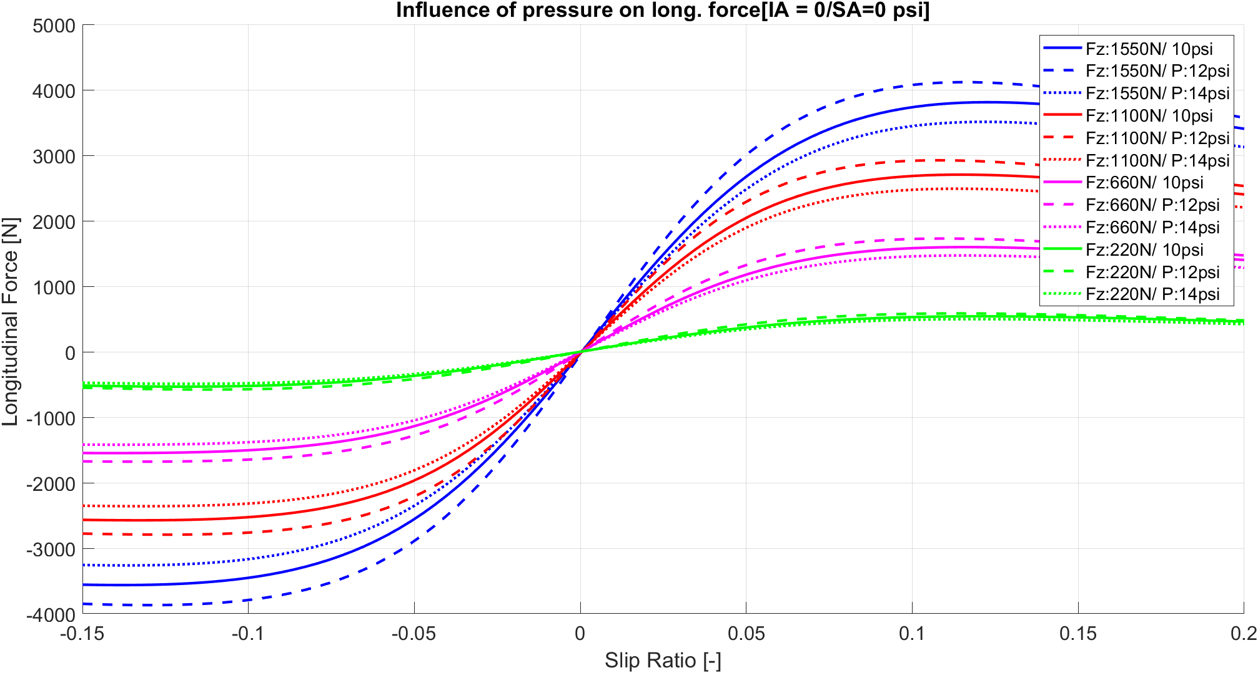
Tire data long. force

Slide 42
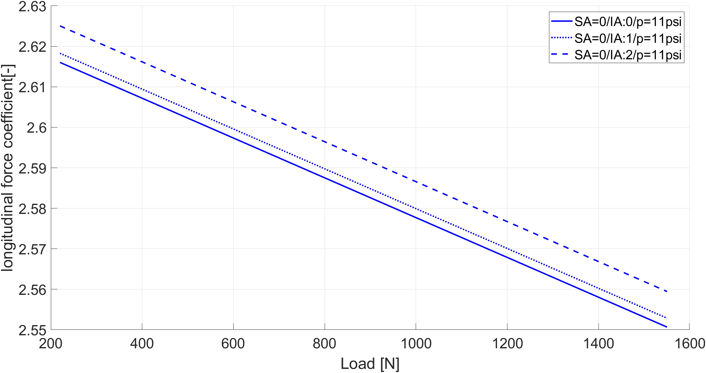
Tire data long. force coefficient

Slide 43
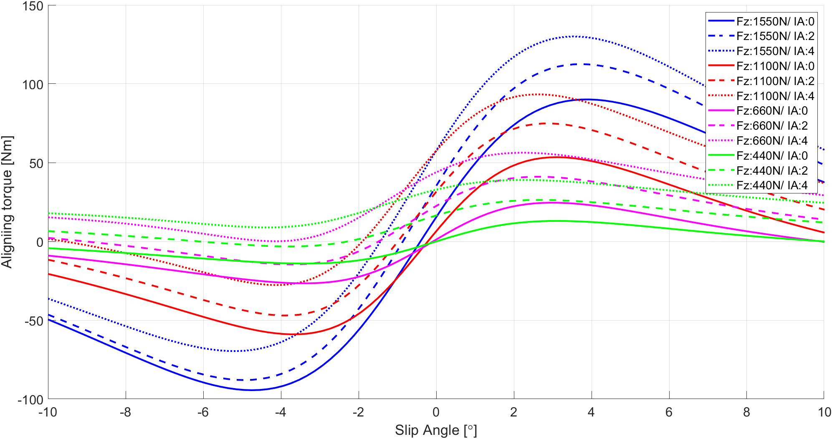
Tire data aligning torque

Slide 44
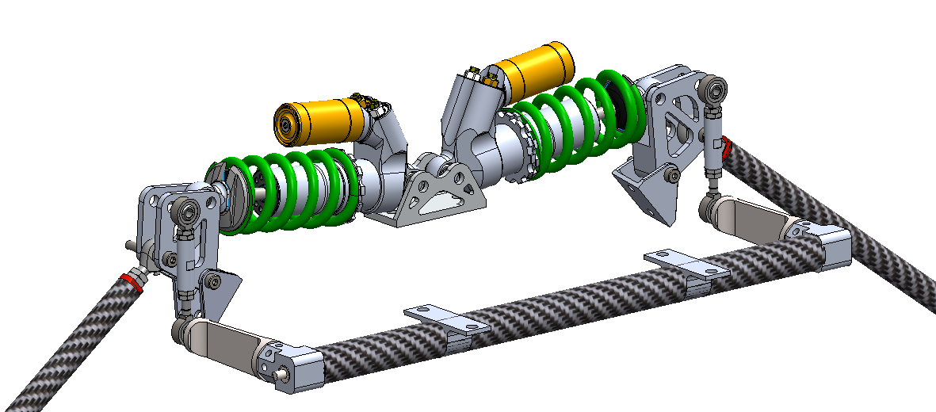
Front suspension mechanism

Slide 45
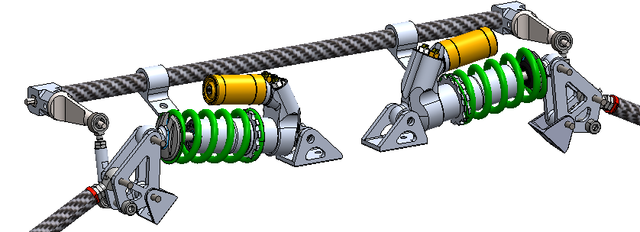
Rear suspension mechanism

Slide 46
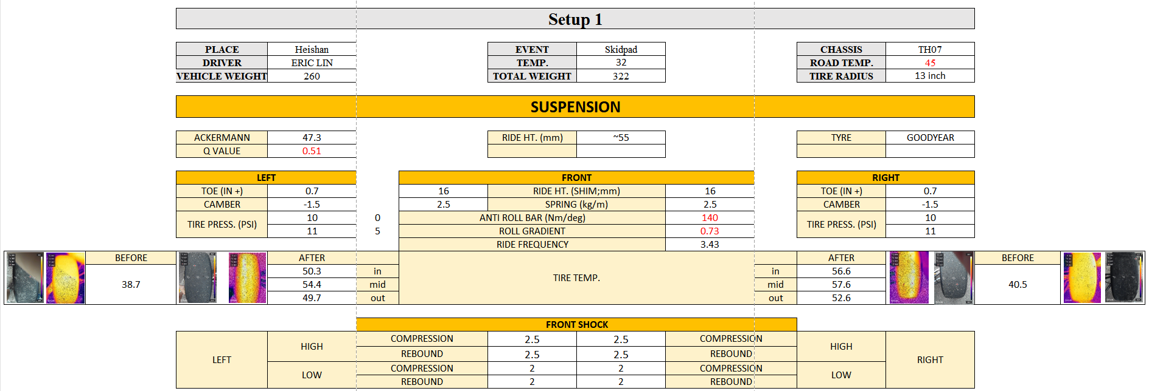
Suspension set up sheet

Slide 47
Suspension parameter
front
rear
Notes:
在轉向特性前後平衡(也就是neutral steer)的前提下，我們透過五種彈簧剛性搭配三種防傾桿扭轉剛性，前懸以及後懸各有15種設定，就全車來說就有225種設定。調整參數的流程如前面所述，先從圈時去調整彈簧剛性，在得到最佳圈時後再根據車手反饋調整防傾桿，配合車手開車風格。
在這麼多種的懸吊設定之下，更需要多做試驗來最佳化車輛。 希望可以在今年的試車期，更掌握彈簧剛性以及防傾桿對車輛表現的影響，才能夠最大化車輛表現，並且可以因應不同的賽道，做出及時的懸吊調整。

Slide 48
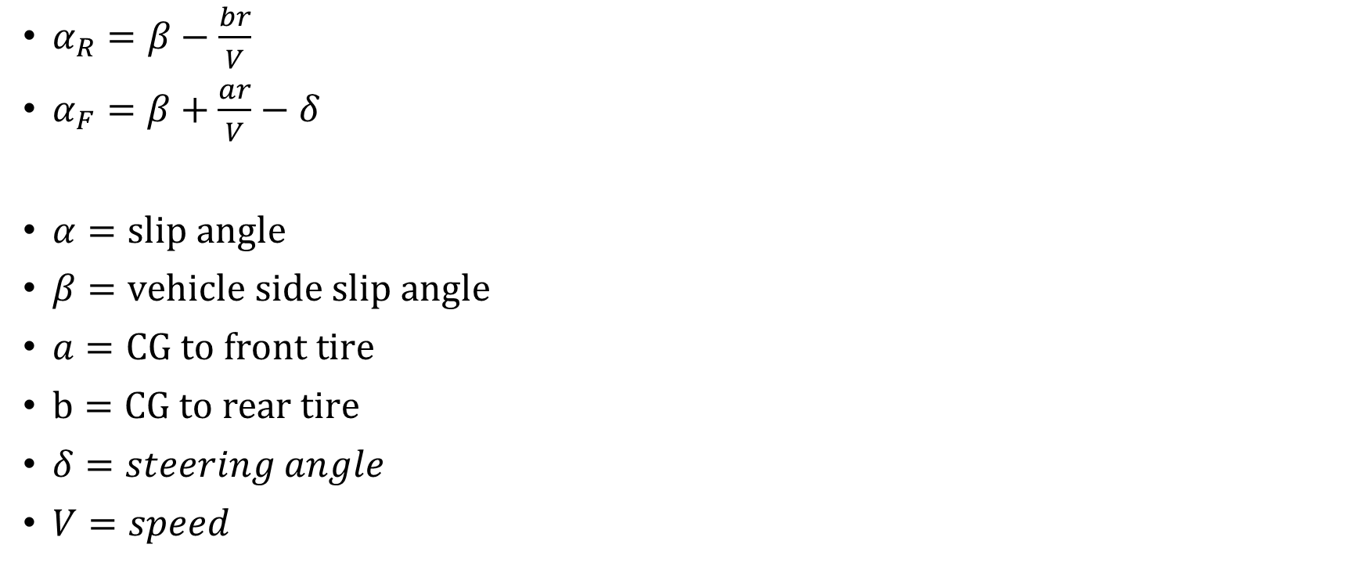
Slip angle estimation model
$α_{R}=β−\frac{br}{V}$
$α_{F}=β+\frac{ar}{V}−δ$
$α=slip angle$
$β=vehicle side slip angle$
$a=CG to front tire$
$b=CG to rear tire$
$δ=steering angle$
$V=speed$

Slide 49
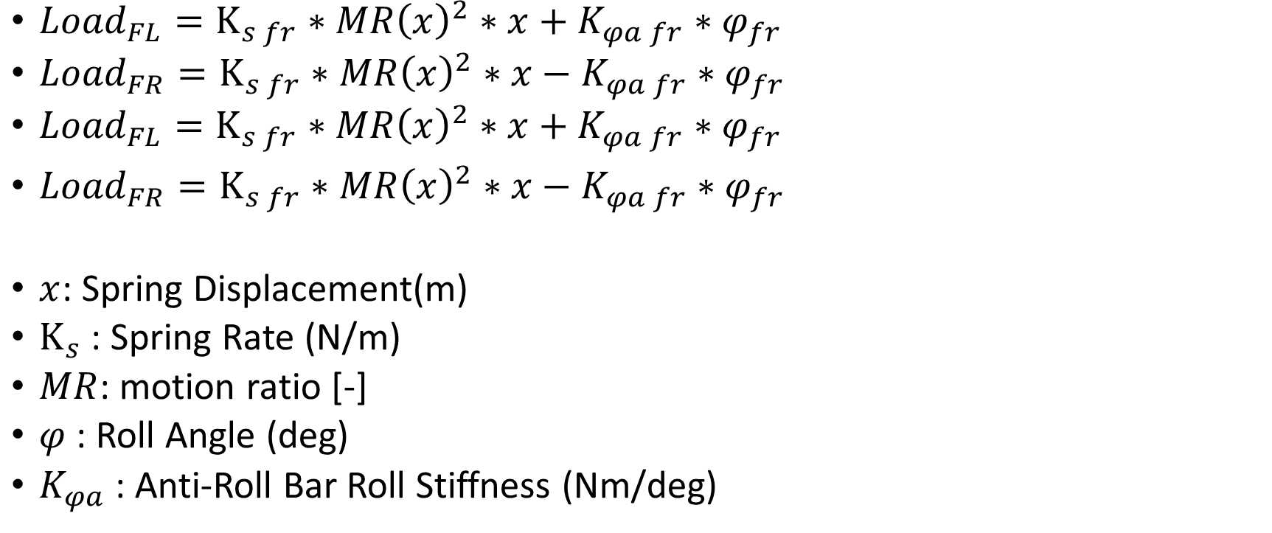
Load estimation model
${Load}_{FL}=K_{s fr}∗{MR\left(x\right)}^{2}∗x+K_{φa fr}∗φ_{fr}$
${Load}_{FR}=K_{s fr}∗{MR\left(x\right)}^{2}∗x−K_{φa fr}∗φ_{fr}$
${Load}_{FL}=K_{s fr}∗{MR\left(x\right)}^{2}∗x+K_{φa fr}∗φ_{fr}$
${Load}_{FR}=K_{s fr}∗{MR\left(x\right)}^{2}∗x−K_{φa fr}∗φ_{fr}$
$x$: Spring Displacement(m)
$K_{s}$: Spring Rate (N/m)
$MR$: motion ratio [-]
$φ$ : Roll Angle (deg)
$K_{φa}$: Anti-Roll Bar Roll Stiffness (Nm/deg)

